Slide 1

Taxes & the IRS
3
F
E
Foundation for Financial Education
www.f3eonline.org | sharon@f3eonline.org | 240-499-0390

Slide 2
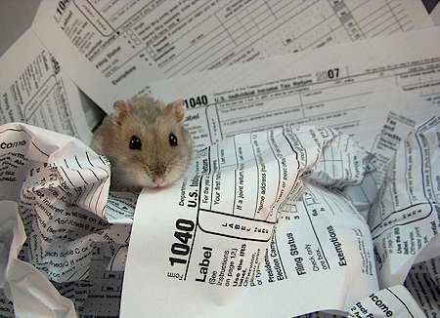
3 Types
Turbo Tax
Tax Preparers
Tax Advisors

Slide 3
NOTES

Slide 4
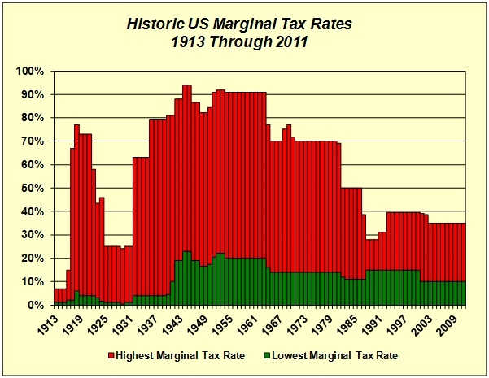
TAX TABLE

Slide 5
NOTES

Slide 6
Tax Planning for Estate
Revocable Living Trust
Wills
Irrevocable Trust
Estate/Inheritance/State Death Tax

Slide 7
NOTES

Slide 8

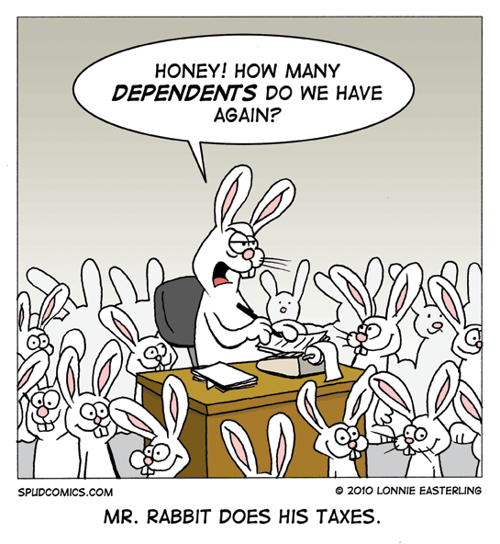
Most Common Tax Mistakes
Social Security Number
1099/W-2 Matching
Not Reporting All Income
Too Aggressive with Deductions
Not Filing Timely Return
Tracking Basis
Claiming All Dependents

Slide 9
NOTES

Slide 10

Itemized Deductions
Typical Deductible Expenses
  Mortgage Interest
  Property Taxes
  Charitable Contributions/Donations
  State and Local Income Taxes vs. Deductible Sales Tax
  Vehicle Registration
  Medical Expenses (Over 7.5% of AGI)
  Tax Preparation Expense
  Other Miscellaneous Deductions
  Gambling Losses

Slide 11
NOTES

Slide 12

Filing Status
5 Types
  Single
  Married filing Joint
  Married filing Separate
  Head of Household (Be careful!)
  Qualifying Widower with Dependent Child
Marital Status Determined on last day of year
Married Filing Separate-If one spouse itemizes then the other MUST also itemize.

Slide 13
NOTES

Slide 14
If you are ready to act…..
You are entitled to a Complimentary Consultation
What you will get:
  A Review of
    Your Financial Profile
    Your Tax Efficiency
    Your Tax Planning Options
Recommendations for Action

